Slide 1



ABAP on Hana s/4 Hana Training
Day 17
contact@anubhavtrainings.com

Slide 2

Agenda – Day 17
Add Validation ,Determination ,Action
Describing SAP Analytics Cloud ( SAC )
Consume CDS in Analytics Cloud
Creating Dashboard’s on top of CDS in Analytics Cloud

Slide 3
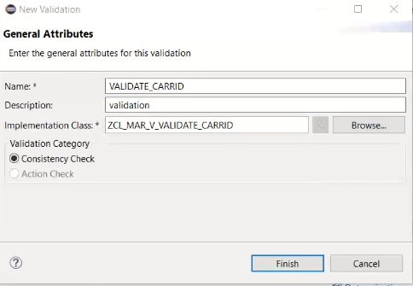
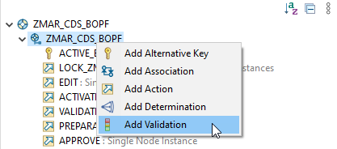
Validation
If this condition is fulfilled, the BOPF runtime automatically executes the validation. We call this implicit validation. Implicit validations are executed after each modification of node data, depending on the configured request nodes. A validation is an entity of a business object node that is triggered in certain situations to check various aspects of a given set of node instances. It is used used to validate whether a set of node instances is consistent.
Right Click on Business Object and Add Validation
Exercise
Implementing Validation

Slide 4
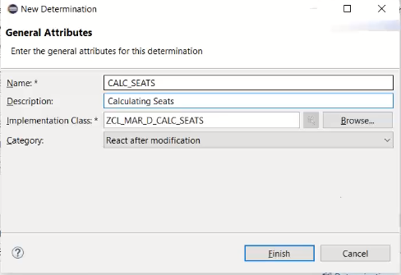
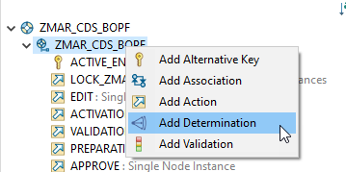
Determination
The Determination, change of business objects, such as saving, is the logic that moves when certain conditions are met.
Right Click on Business Object and Add Determination
Exercise
Implementing Determination

Slide 5
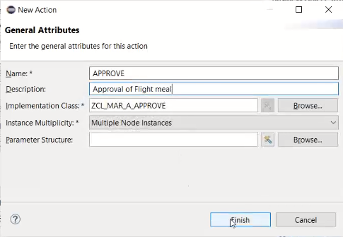
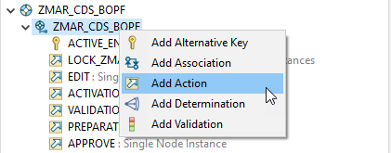
Action
Are the operations which are non-standard for a business object. Using these actions, we can also perform the CRUD with the help of BO.
The BOPF framework assigns the new action to the business object node and creates an action class that implements the BOPF action interface /BOBF/IF_FRW_ACTION .
Right Click on Business Object and Add Action
Exercise
Implementing Action Code

Slide 6
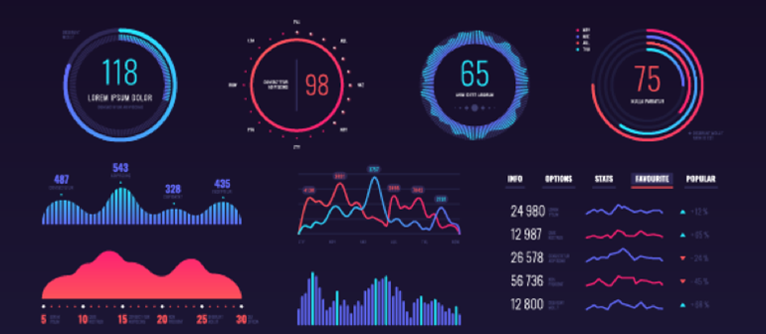
SAP Analytics Cloud ( SAC )
The SAP Analytics Cloud solution combines BI, augmented and predictive analytics, and planning capabilities into one cloud environment. As the analytics layer of SAP's Business Technology Platform, it supports advanced analytics enterprise-wide.
SAP Analytics cloud is a SaaS offering by SAP for complete BI, Planning, Predictive and designer capabilities.

Slide 7
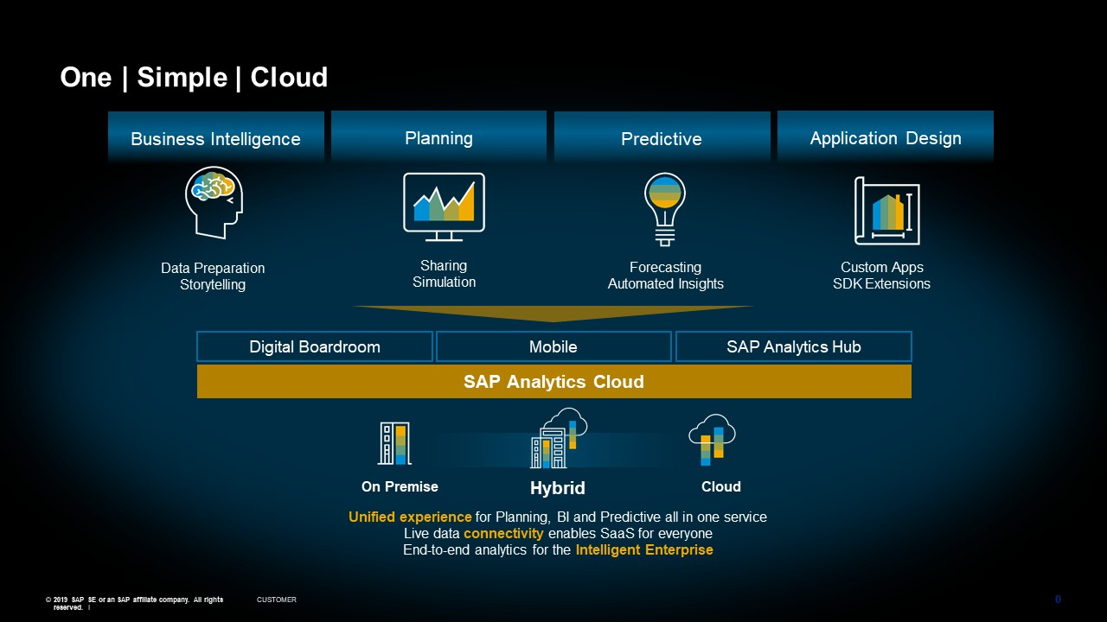
Phases of SAP Analytics Cloud ( SAC )

Slide 8
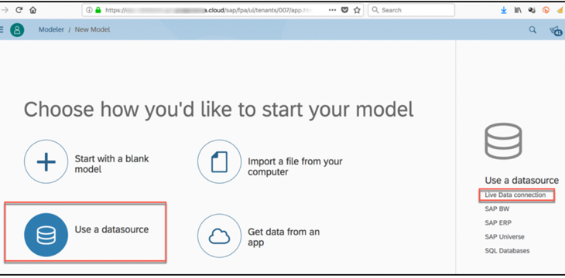

Consume CDS in Analytic Cloud
With Live Data
Connection

Slide 9

Exercise
Consume CDS in Analytics Cloud Code

Slide 10
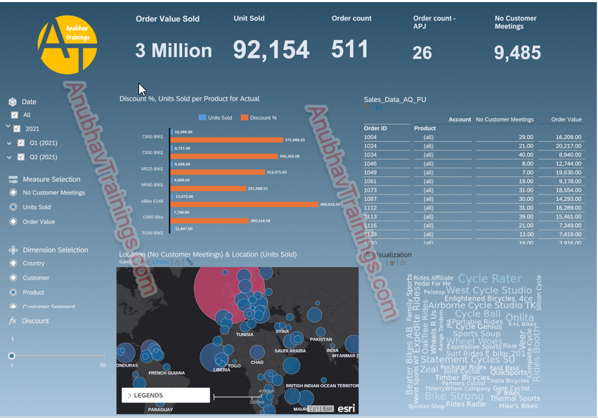
SAC Dashboard on top of CDS

Slide 11

End of Day 17
Trainer: Anubhav Oberoy

Slide 12

Trainer: Anubhav Oberoy

Slide 13
THANK YOU
If you cannot do
great things, do small things in a great way.
Anubhav Oberoy
https://www.anubhavtrainings.com

Slide 14


We’re committed to empower you to be
Most Desirable Resource
through powerful training solutions.
We build the workforce of the future.
250+
Corporate Clients
30,000+
Learners Trained
25000+
Learners Placed
FREE WEBINARS
Sign up for free webinars with industry experts every fortnight!
Enroll Now!
Contact us today!
https://anubhavtrainings.com/

Slide 15




More from AnubhavTrainings.com

